Slide 1
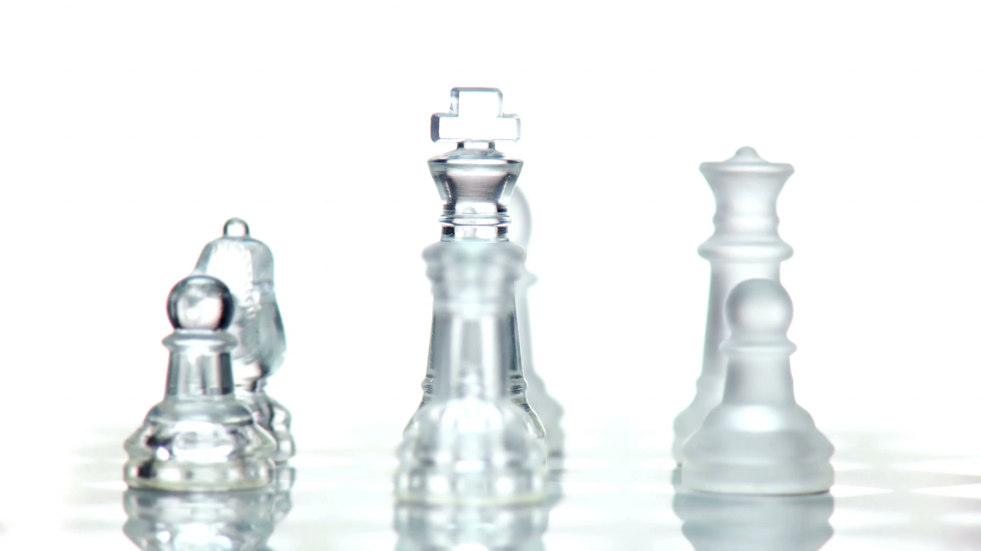
CNN vs. Transformer in Chess- Contradicting Metrics
Members: Yasmin Mitkal, Omar Garah, Yazan Otman

Slide 2
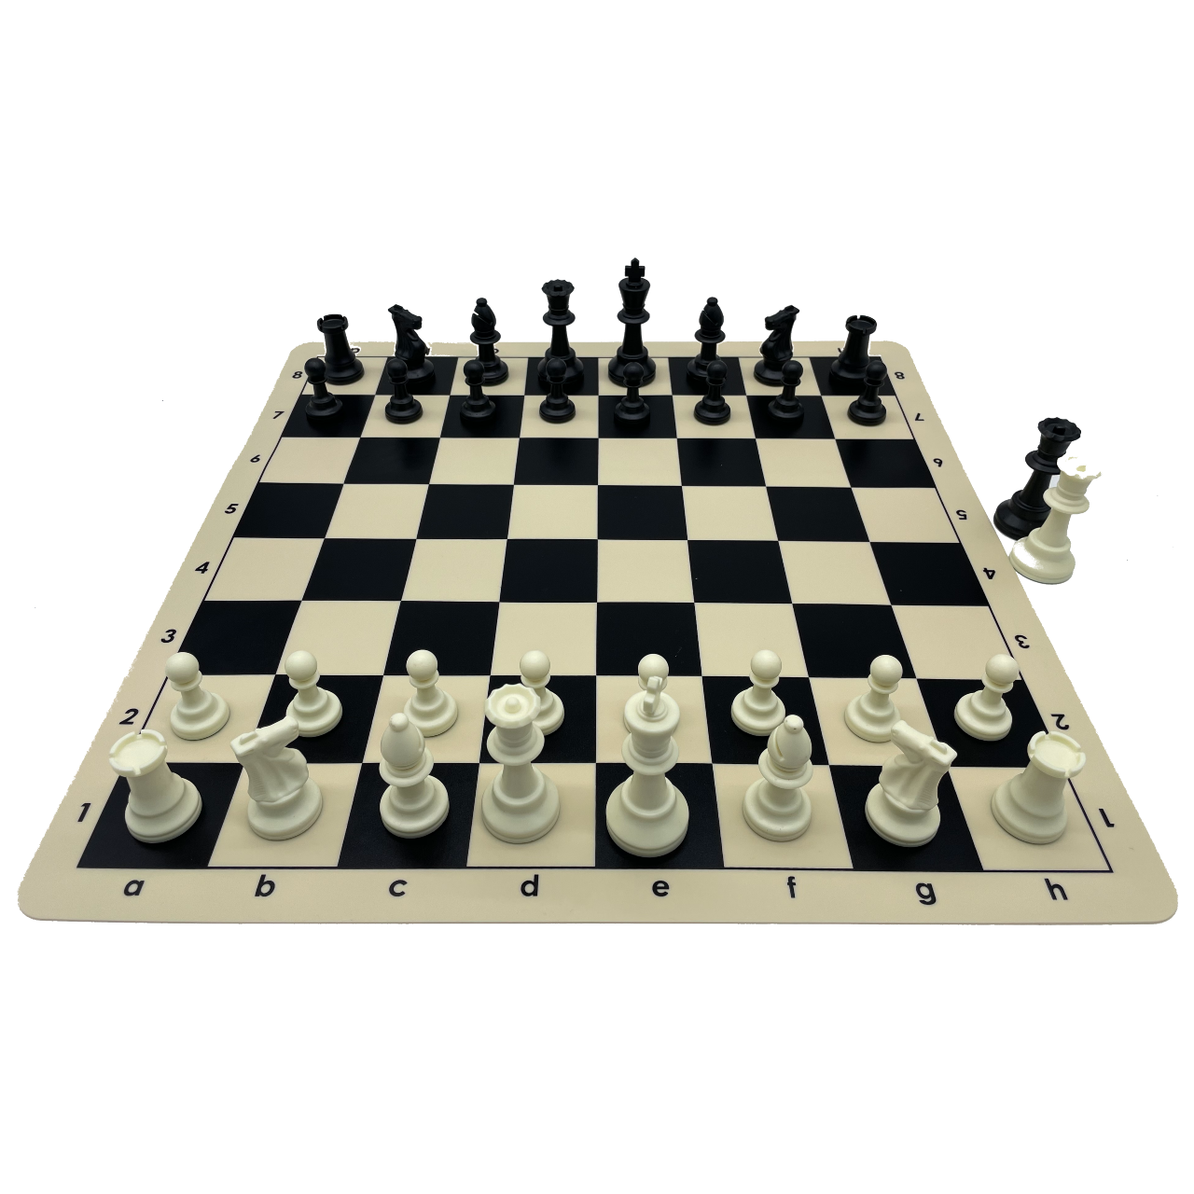
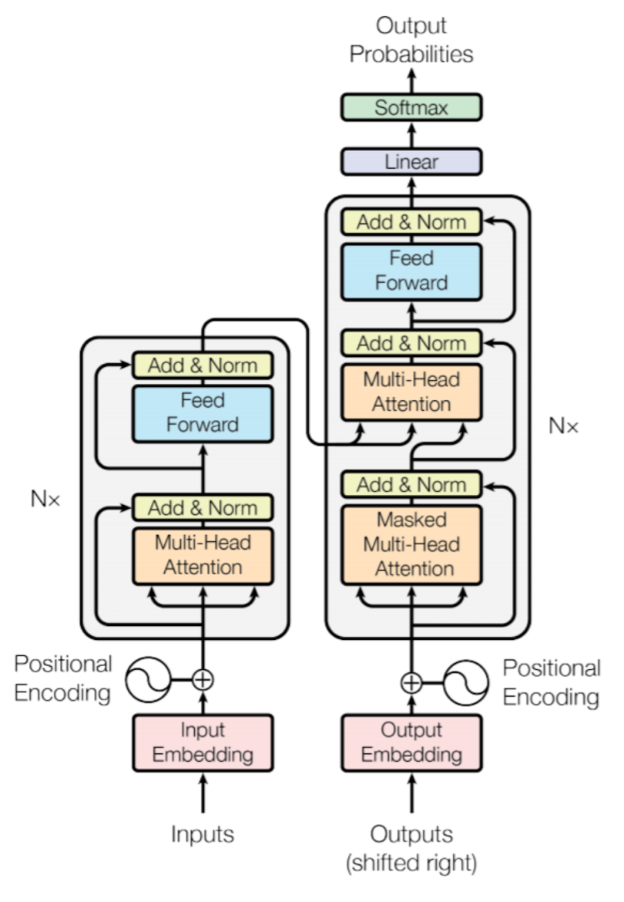
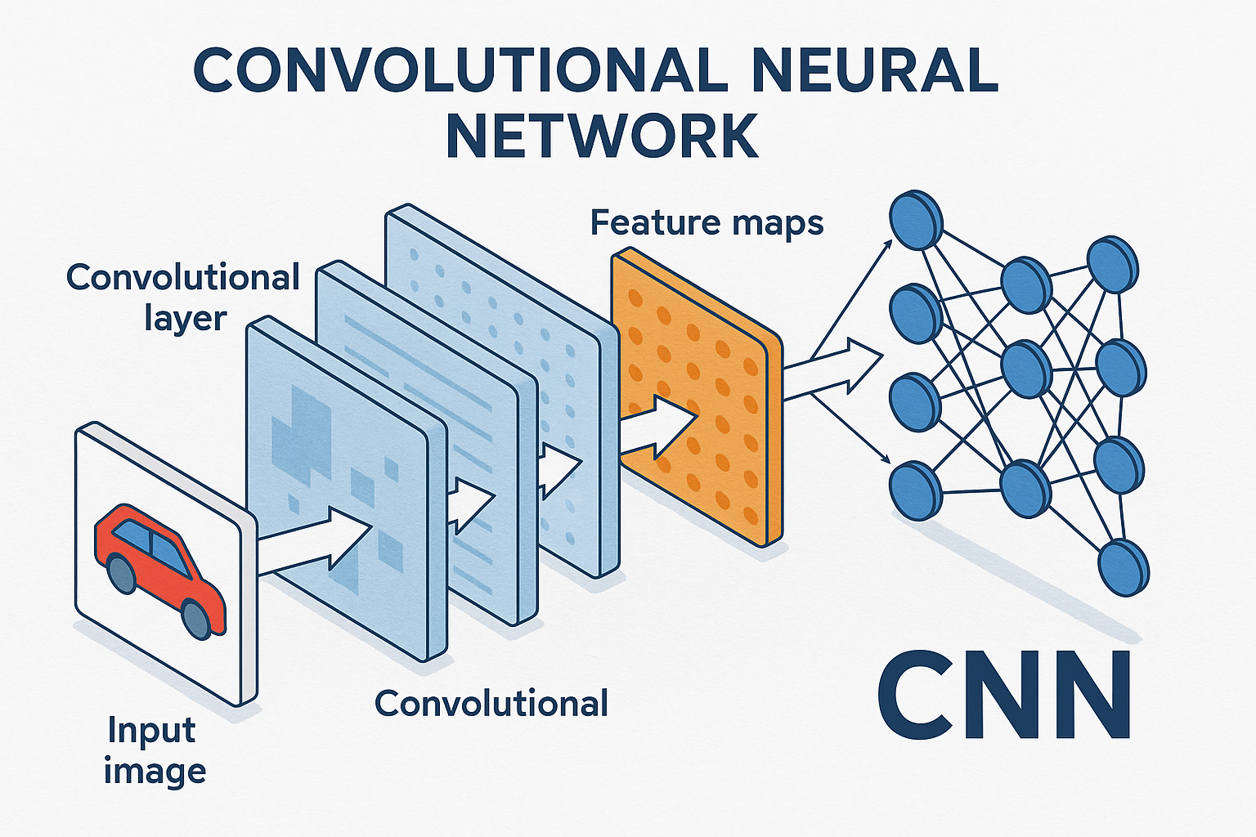
Data Generation
Train CNN & Transformer
Run head-to-head games
Measure puzzle accuracy (correct move rate)
Vs.
Notes:
Trained a CNN and a Transformer on publicly available chess data under comparable conditions.
Generated a game-play dataset by having the trained models play head-to-head chess games and recording wins, losses, and draws.
Generated a puzzle dataset by evaluating each trained model on chess puzzles and measuring accuracy as the percentage of puzzles where the correct move was predicted.

Slide 3

Unexpected Phenomenon
Two Metrics, Two Conclusions, One surprise
Head-to-head: Transformer wins
Puzzle accuracy: equal players
Winning More, Not Smarter?

Slide 4
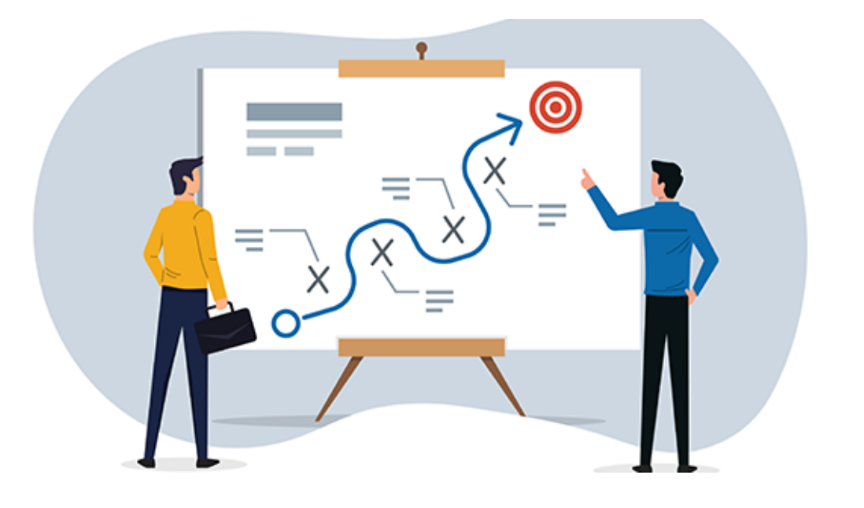
Plan for Investigation
Examine performance differences across difficulty and themes
Identify important puzzle types associated with strong play
Re-evaluate accuracy: Top-5 instead of Top-1
Notes:
Identify when each model performs better by analyzing accuracy across puzzle difficulty and themes, guided by a causal DAG to identify confounders.
Examine task importance by detecting which puzzle types and difficulty levels are most associated with strong play.
Re-evaluate performance using broader accuracy measures (Top-5 instead of Top-1) to account for noisy labels and alternative correct moves.

